Slide 1
THE RUSSIAN BOOK INDUSTRY
Surviving the pandemic

Slide 2
The total industry turnover (both digital and printed copies) at the end of 2020 showed losses of 9%. This points to the mild impact the pandemic has had on the book business in Russia. The main reason behind this negative trend is significant losses in the retail market of printed books (-12.6%). Even stable budget purchases of books and the growth in the sales of e-books and digital books services (+1.8 bil. RUB) could not make up for these losses.
Printed books, bil. RUB
Digital books, mil. RUB
total

Slide 3
According to data from the Russian Book Chamber (RCP), the total number of titles released in 2020 decreased by 13.3%, alongside the drop of 6.8% in average circulation. As a result, the physical volume of book releases decreased by roughly a fifth (-19.3%) in comparison with the statistics from 2019. This is the second year in a row that publishers are decreasing funding for adult literature as well for the release of children’s fiction. Since 2017, the negative trend in the release of professional literature has continued. But even so, the Russian book industry still prints more than 350 million books and brochures a year, of which only two thirds are sold.
Trend between the release of titles and the average print run of printed publications in the Russian Federation
number of titles
average print run (number of exemplars)
Relationship between the volume of book releases and the sale of publications in the Russian Federation
release of books and brochures (thousands of exemplars)
sale of books and brochures (thousands of exemplars)

Slide 4
Governmental support
In 2020, the government gave the book industry more attention than it has in the last 20 years:
In accordance with resolutions issued by the Government of the Russian Federation (Resolution of April 18, 2020 № 540; Resolution of April 24, 2020 № 576; Resolution of May 16, 2020 № 696; Resolution of May 26, 2020 № 745), book publishing and the book retail business earned the right to tax remissions, subsidies and loss assets under the status of “most affected sectors” of the economy, due to the negative effect of COVID-19.
In accordance with the Resolution of October 9, № 1643, the Government of the Russian Federation halved the rate of VAT on e-books and audiobooks.
In accordance with Federal Law № 323 of October 15, 2020, Article 264, Part Two of the Internal Revenue Code of the Russian Federation, an amendment was introduced aimed at increasing the volume of write-offs of illiquid book production from 10 to 30%.

Slide 5
 | 2020, bil. RUB | %% until 2019 | 2021, bil. RUB prediction | Effect of COVID, bil. RUB
Online sales of printed books (marketplace) | 17.745 | +25.89 | 18.250 | +3.650
Digital book MARKET | 8.350 | +28.26 | 9.700 | +1.840
Institutional sales BUDGET of printed books | 16.125 | +0.83 | 16.100 | +0.133
Offline sales of printed books (i.e. bookshops and FMCG) | 34.938 | -24.38 | 39.330 | -11.267
In 2020, the Russian book industry’s infrastructure proved to be unprepared for the jump to an online domain: booksellers’ main source of revenue in 2020 came from selling printed publications in bookshops (43.8%) and at the auctions of state-funded institutions (23.1% of earnings)
In comparison with 2019 and 2020, the sales of printed books bought from the internet has grown by 25.9%, amounting to 17.7 bil. RUB. But in comparison with the overall rate of progression of e-commerce in Russia (which has seen a growth from 1.45 to 2.78 tril. RUB), the book industry has not realised the full potential of online stores.
Despite new opportunities, Russian digital book publishing and distribution in 2020 remained within the framework of their original growth rates, and the total volume of the digital book sector at the end of 2020 still only made up 12% of the turnover of printed books.

Slide 6
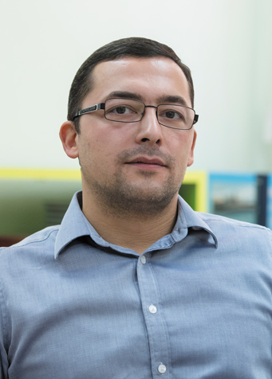
In the midst of the pandemic and a sharp drop in economic activity, the disposable income of Russian people in 2020 was only 89.4% of what it was in 2013. Other than the virus, people living in Russia were faced with the escalation of inflation and the devaluation of the rouble. And although books remain one of the most accessible goods for Russian citizens, nonetheless instead of the predicted increase in price of 8-10%, the price of printed publications in the book market in 2020 has, in fact, only increased by 0.13%; the average price reached 300.39 roubles. For 2021, a significant increase in the average price for a book is predicted due to the price-rise of the expendable materials required in the production of a paperback book.
The average price of a book bought in the Russian Federation
 | 2016 | 2017 | 2018 | 2019 | 2020 | 2021 F
Average Price of Printed Book, RUB | 256.87 | 266.36 | 284.64 | 299.99 | 300.39 | 335.20
Annual Inflation, % | 118.28 | 103.69 | 106.86 | 105.39 | 100.13 | 111.60
Average Price of Digital book, RUB | 113.90 | 173.52 | 174.60 | 181.38 | 192.87
Expert's Opinion
In Russia, publishers are not allowed to set retail prices in sales points as this is illegal under the current legislation: “Setting prices for competitors in the goods market is considered as creating a cartel, which is prohibited according to Art. 11 of the Antitrust Law”. This means that publishers can only influence retail prices indirectly through their own pricing system, taking into account all the sales channel parameters and features, i.e. discounts, bonuses, deferred payments and compensations along with channel mark-up, turnover rate etc.
Aleksandr Boguslavskiy, AST

Slide 7
How much should a book cost?
% responses, closed question, one answer option allowed
What bookstore
visitors think
Data from an opinion poll of people visiting bookstores located in Moscow (1000 responses were sampled according to the geographical distribution of offline sales points, Sep 23-28, 2020)
Adult fiction
Children’s books
100-300 roubles
more than 500 roubles
300-500 roubles
other

Slide 8
Expert's Opinion
The most remarkable development over recent years is that new authors are born and marketed online, to be later successfully monetized offline. However, this does not make the Russian market less conservative: no other market in the world except Russia has a reprint share of over 50%.
Leonid Shkurovich, Azbuka-Atticus
bestsellers in the Russian book market

Slide 9
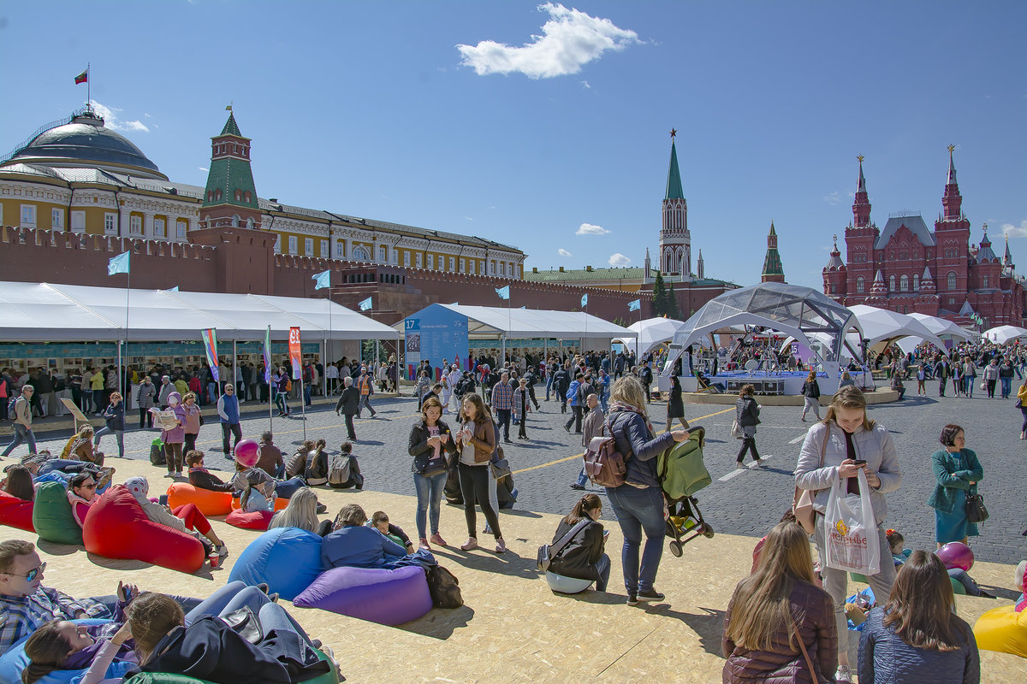
Book and Reading Promotion in Russia: online national Initiatives in 2020
BIBLIONIGHT (an annual socio-cultural event (created in 2012) dedicated to reading that takes place in April across the whole of Russia. During this night, libraries, bookshops, and literary museums have longer opening hours and branch out into other artistic spheres. The aim of the event is the development of the library, museum, and book business, the popularization of reading, and the organisation of new forms of cultural leisure for Russia’s citizens)
TOTAL DICTATION (an annual educational event (created in 2004) that simultaneously takes place in Russia and different countries around the world with the aim of popularizing the Russian language. The authors of the texts for dictation include famous authors, opinion journalists, and both classical and contemporary philosophers. Famous cultural figureheads are invited to dictate these texts. In 2020, a piece by Andrei Gelasimov was read out)
LIVE CLASSICS (an annual competition for young readers (created in 2013) wherein participants read Russian prose aloud. It is the most widespread children’s literature educational project in Russia; every year over 2.5 million people from 85 different regions of the country take part. The competition’s goal is to popularize reading among teenagers and expand their horizons when it comes to reading)
BIG BOOK (a national literary prize (established in 2005) for the best work of prose written in Russian. Past laureates have been Daniil Granin, Vladimir Sorokin, Lyudmila Ulitskaya, Evegenii Vodolazkin, Leonid Yusefovich, Zakhat Prilepin, Guzel Yakhina, Lev Danilkin et al. In 2020, Aleksandr Ilichevsky placed first with his book “Newton’s Sketch”)
THE MOST READING REGION (a nationwide competition among the subjects of the Russian Federation for the title of “The Literary Flagship of Russia”. It is intended to appreciate and encourage the contribution of different regions to the development of literature in the country’s cultural sphere, as well as their efforts in making reading more accessible Russia’s inhabitants. This annual competition was launched as part of the Year of Literature in Russia. The honorary title of “The Literary Flagship of Russia” has been bestowed upon the Ulyanovsk Oblast (2015), the Voronezh Oblast (2016), Saint-Petersburg (2017), the Irkutsk Oblast (2018), the Belgorod Oblast (2019), and the Republic of Sakha (2020).

